Slide 1


Department of English
Module 3
Session - 8
Topic: Foundations of Effective
Professional Writing
Principles, Practices & Application

Slide 2
AIM OF THE SESSION
To equip learners with the core principles and skills needed to produce clear, concise, and credible professional documents across diverse workplace contexts.
INSTRUCTIONAL OBJECTIVES
This Session is designed to:
Guide participants through audience and purpose analysis, helping them identify what readers need to know, feel, or do in different professional communication contexts.
Demonstrate techniques for achieving coherence and cohesion in writing through transitions, signposting, and given-to-new information flow, using authentic workplace communication examples
LEARNING OUTCOMES
At the end of this session, you should be able to:
Apply the 7 Cs to professional documents.
Analyze audience and the communication purpose. Use transitions, signposting, and logical flow effectively. Produce clear, coherent, and reader-focused professional writing.

Slide 3

INTRODUCTION
In this session, you will learn:
I. The qualities of effective professional writing (The 7 Cs)
II. Audience and Purpose Analysis
III. Coherence and Cohesion

Slide 4
Problem / Case Analysis
The Confusing Event Announcement
A student coordinator is informing participants about a workshop.
Please register using the QR code before 15 August. Participants are requested to report by 9:15 a.m. Dear Students, Certificates will be issued only to participants attending the complete session. The Department of English is organizing a workshop on "Professional Writing in the AI Era" on 18 August. For any queries, contact the event coordinator. Thank you. The venue is Seminar Hall-2.
❌ BEFORE

Slide 5
Problem / Case Analysis
The Confusing Event Announcement
✅ AFTER
Dear Students,
The Department of English is organizing a workshop on "Professional Writing in the AI Era" on 18 August. The venue is Seminar Hall-2. Participants are requested to report by 9:15 a.m. Please register using the QR code before 15 August. Certificates will be issued only to participants attending the complete session. For any queries, contact the event coordinator. Thank you.

Slide 6
Problem / Case Analysis
Analysing an Email — Before vs. After Revision
❌ BEFORE (Original Email)
Subject: Update
Hi,
Just wanted to touch base regarding the deliverable situation. As per our previous correspondence, it has been observed that there have been certain issues with respect to the timeline due to scope-related parameters that were encountered by our team.
Kindly revert at your earliest convenience.

Slide 7
Problem / Case Analysis
Analysing an Email —After Revision
Key Improvements
→ Vague subject → Specific subject with date
→ Jargon removed → Plain English used
→ Passive voice → Active, direct sentences
→ No action item → Clear CTA with deadline
→ Ambiguous tone → Confident and courteous
Subject: Project Timeline Update — Delivery Extended to 15 July
Dear Ms. Sharma,
I am writing to inform you that due to a client-approved scope addition (approved 3 July), our delivery date has moved from 10 July to 15 July.
Action required: Please confirm if this revised date works for your team by 8 July.
I am available for a call this week if you have questions.

Slide 8
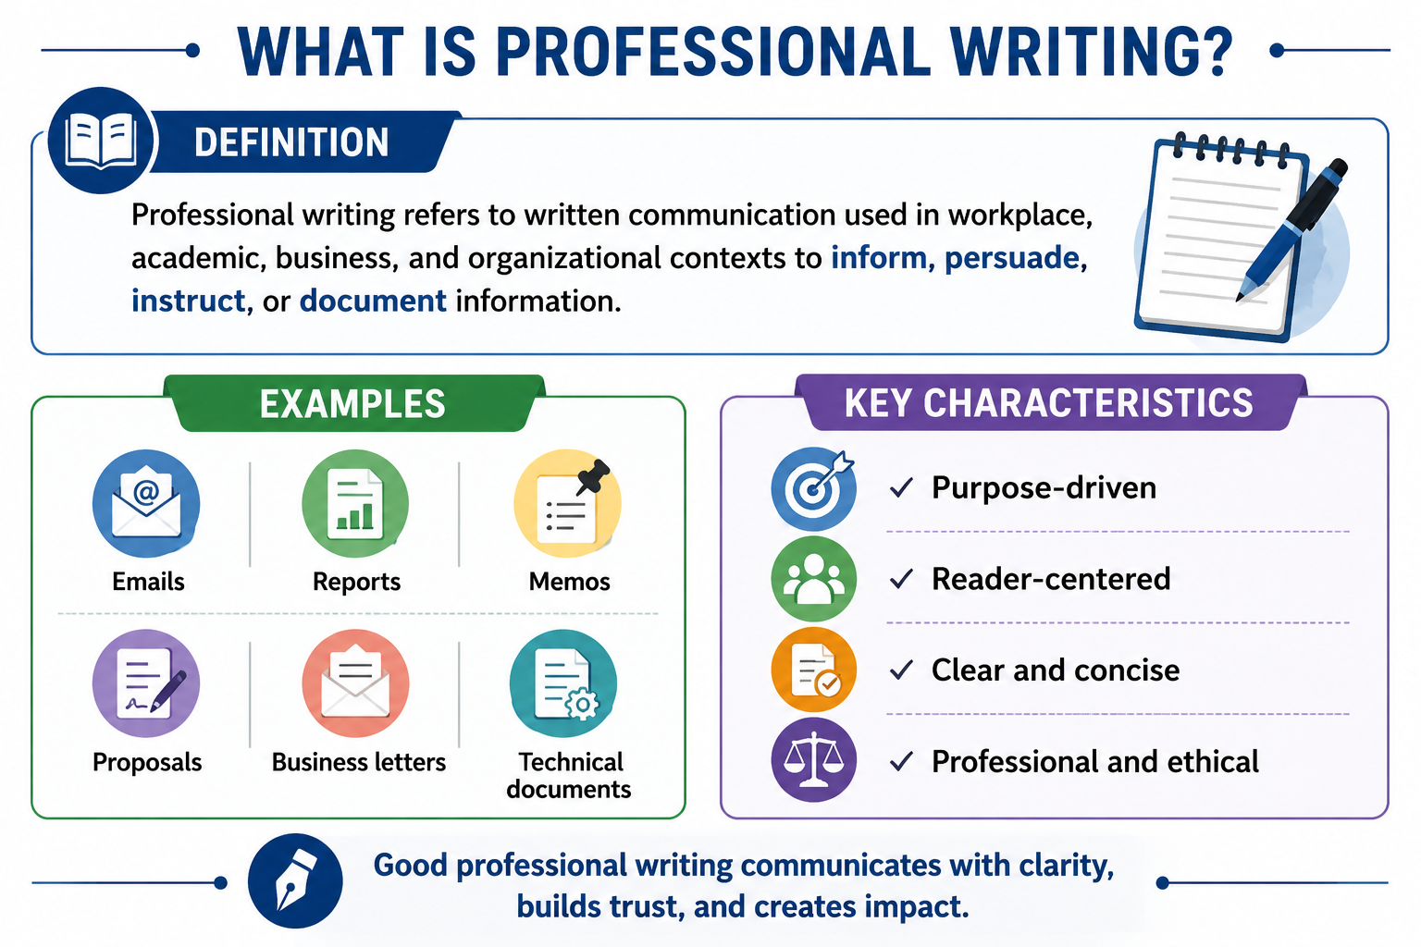

Slide 9
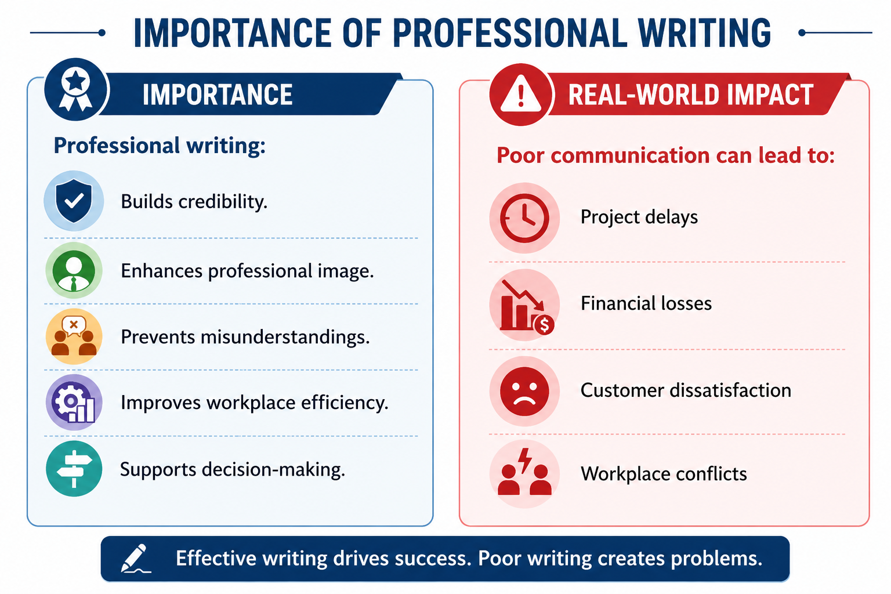

Slide 10
I- The 7 Cs of Effective Professional Writing — Part I
Qualities that define excellence in professional communication
✅
s
💡
Clarity
Correct
The reader understands the message on first reading — no ambiguity, no re-reading needed.
Accurate in grammar, spelling, punctuation, data, and facts. Errors destroy credibility.
❌ The utilisation of convoluted sentence structures may engender comprehension difficulties.
✅ Use short sentences. Say what you mean directly.
❌ The meeting is schedule for Tuesday, 14th july at 2 pm.
✅ The meeting is scheduled for Tuesday, 14 July at 2:00 PM.
✂️
Concise
📋
Complete
Every word earns its place. Brevity is not sacrificing content — it's removing excess.
Includes all information the reader needs to act, decide, or respond. No missing pieces.
❌ I am writing this email in order to inform you about the fact that...
✅ I am writing to inform you that...
❌ Please send us the documents soon.
✅ Please send the signed NDA and project brief to hr@firm.com by Friday, 27 June, 5 PM IST.

Slide 11
The 7 Cs of Effective Professional Writing — Part II
🤝
Courteous
👁️
Considerate
🧱
Concrete
Respectful, polite, and positive. Avoids sarcasm, condescension, or aggressive language.
Centres the reader's needs, knowledge, and perspective — not just the writer's.
Uses specific facts, measurable data, and vivid examples instead of vague generalities.
❌
❌
❌
As I already stated in my previous email, the deadline was missed.
Refer to Section 4.2(b)(iii) of the aforementioned circular for further details.
Sales improved significantly this quarter, showing great results.
✅
✅
✅
To recap our earlier discussion, the deadline has passed — could we agree on a revised date?
For details on this policy, see page 12 of the attached circular (Section 4.2).
Sales rose by 28% in Q2 2026, driven by a 40% increase in enterprise client sign-ups.
💡 Quick Self-Check: Before sending, ask — Is this Courteous in tone? Considerate of the reader? Concrete with evidence?

Slide 12
II - Audience & Purpose Analysis
🎯 The Golden Rule: Know WHO you are writing for and WHY before you write a single word.
👥 Audience Analysis
🎯 Purpose Analysis
Ask yourself these key questions:
Every professional document has a primary purpose:
Who are they?
Expert / non-expert / decision-maker / peer / external client
Inform
Status report, meeting minutes, newsletter
What do they know?
Persuade
Assume their background knowledge accurately — avoid over- or under-explaining
Proposal, sales pitch, recommendation letter
What do they need?
Request
Information, a decision, an action, reassurance, or approval?
Email asking for data, approval, or a meeting
What is their attitude?
Receptive / sceptical / neutral / hostile — tone must match
Instruct
SOPs, training manuals, how-to guides
What is the context?
Formal org culture, urgent situation, multicultural audience?
Record
MoM, incident reports, audit logs

Slide 13
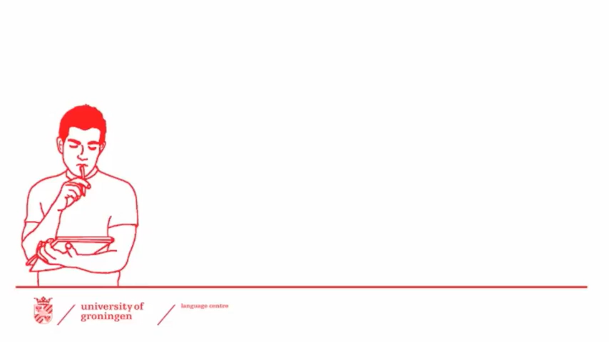
Video: Audience & Purpose Analysis

Slide 14
III. Coherence & Cohesion in Professional Writing
🔗 Cohesion
🧩 Coherence
The surface-level linguistic links that connect sentences and paragraphs — pronouns, conjunctions, transition words, and repetition of key terms.
The deeper logical organisation of ideas — each paragraph has a clear purpose, ideas flow in a logical order, and the whole document makes unified sense.
Cohesion Devices
Coherence Principles
Transitional:
One Idea Per Paragraph
However, Therefore, Furthermore, Consequently, In addition, Nevertheless
Each paragraph has a topic sentence, supporting detail, and a link to the next.
Referential:
Logical Sequencing
this, these, that, those, it, they, he, she (link back to earlier nouns)
General → Specific, Problem → Solution, Chronological, or Order of Importance.
Additive:
Consistent Focus
also, moreover, in addition, equally, likewise, similarly
Stick to the document's stated purpose — don't introduce unrelated ideas.
Contrastive:
Signposting
however, although, despite this, on the other hand, yet, whereas
Use headings, sub-headings, and numbered sections to guide the reader.
Causal:
Parallel Structure
because, since, as a result, therefore, consequently, due to
Use consistent grammatical patterns in lists and headings for clarity.
📝 Activity: Identify the cohesion devices and structural signals in the paragraph on Handout C. Label each type.

Slide 15

Video: Coherence & Cohesion

Slide 16
Session Summary
Foundations of Effective Professional Writing
Purpose drives format
The 7 Cs are your checklist
Always identify who you're writing for and why before you begin.
Clear, Concise, Correct, Complete, Courteous, Considerate, Concrete.
Structure signals professionalism
Tone matters as much as content
Opening → Body → Closing, with a clear call to action.
Active voice, positive framing, and reader respect win every time.
Revision is not optional
Every professional document deserves at least one round of editing.
"The difference between the almost right word and the right word is the difference between the lightning bug and the lightning." — Mark Twain

Slide 17
Self-Assessment Questions
1
Scenario-Based
Your manager asks you to inform 200 employees about a surprise policy change effective immediately. Which document type would you choose — email, memo, or report? Justify your choice using principles of audience analysis and urgency.
2
Analytical
A colleague argues that bullet points make writing 'unprofessional'. Critically evaluate this claim with reference to formatting principles and document purpose.
3
Evaluative
Review the sample internal memo provided (Handout B). Identify violations of the 7 Cs, suggest corrections, and rate overall effectiveness on a scale of 1–10.
4
Creative Application
Draft a 150-word executive summary for the ArrowTech case outcome. Your audience is the Board of Directors — non-technical, time-poor, and results-focused.
5
Reflective
Think of a real professional or academic writing task you completed. Identify one principle from this session you wish you had applied. Explain how it would have improved your output.

Slide 18
Terminal Questions
Q1. Define professional writing and list any four characteristics that distinguish it from informal communication.
2 Marks
2 Marks
Q2. What does the acronym '7 Cs' stand for? Briefly explain any three Cs with one example each.
Q3. Differentiate between a business email and a formal memo in terms of format, tone, and appropriate use. Provide one example scenario for each.
Q4. Explain how audience analysis influences decisions about vocabulary, format, and tone in professional documents. Illustrate with two contrasting examples.
Q5. You are the HR Manager of a company introducing a mandatory weekend shift policy for one month. Draft a formal memo to all employees (approx. 250 words) announcing this change. Ensure your writing adheres to the 7 Cs and follows correct memo format.

Slide 19
REFERENCES FOR FURTHER LEARNING OF THE SESSION
https://www.21kschool.com/in/blog/how-to-overcome-stage-fear/
https://www.sandrazimmer.com/transform-stage-fright-into-authentic-presence/
https://www.rockethealth.app/blog/how-to-overcome-stage-fear-proven-strategies-for-confidence/
https://www.youtube.com/watch?v=zCVX3cqn4ao
https://www.youtube.com/watch?v=_N0QScyQLD0

Slide 20
THANK YOU
Team –LANGUAGE SKILLS FOR ENGINEERS

